Slide 1
Doing More, Different, and Better? Qualitative Methods in Family Business Research
17th Annual Family Enterprise Research Conference
June 15 – June 17, 2023

Slide 2
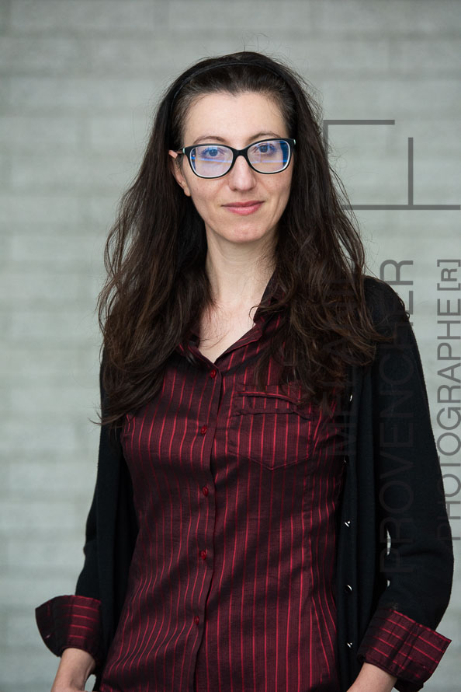
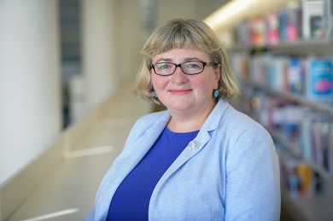
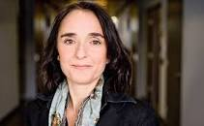
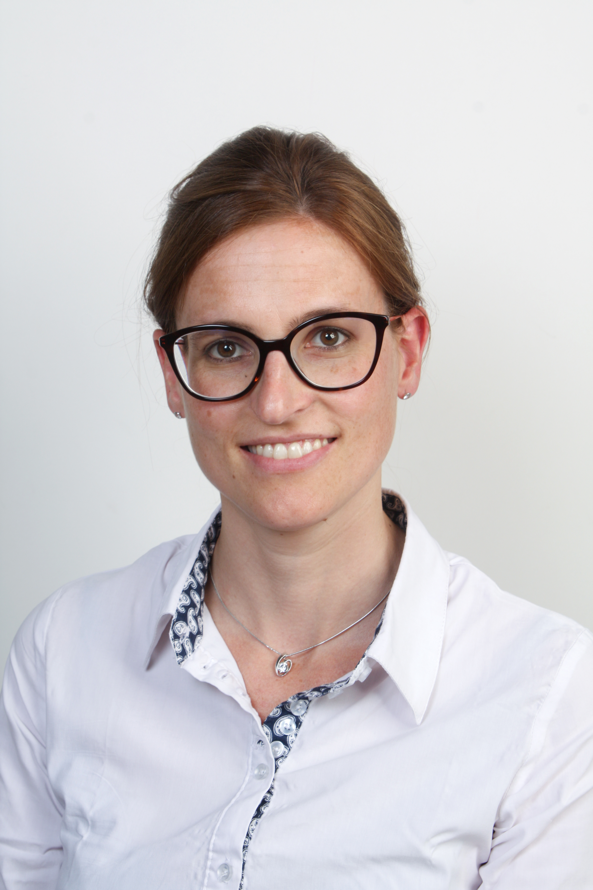
Welcome!
Evelyn Micelotta
University of Ottawa,
Canada
Natalia Vershinina
Audencia Business
School, France
Alexandra Dawson
Concordia University,
Canada
Mara Brumana
University of Bergamo,
Italy

Slide 3
Agenda
Welcome and Introduction
Research design and qualitative/quantitative research in family business research – Alexandra Dawson
On the use of narratives/vignettes in family business research – Natalia Vishinina
Break (5 minutes)
Multimodal methods (visual and text) in family business research – Mara Brumana (on video)
Final panel/Q&A session: Enjoying and publishing successfully qualitative research – Meet three editors - Micelotta, Dawson, and Vishinina

Slide 6
Presentations

Slide 7
Final Panel and Q&A
Evelyn Micelotta – Associate Editor for Family Business Review, Senior Editor for Organization Studies, on the Review Board of Academy of Management Journal, Journal of Management, Journal of Management Studies, Organization Theory, Management and Organization Review.
Alexandra Dawson – Associate Editor for Journal of Family Business Strategy, on the Review Board of Family Business Review.
Natalia Vishinina – Associate Editor for Journal of Business Research, International Journal of Entrepreneurial Behavior & Research and on the review board of Entrepreneurship and Regional Development Journal.

